Slide 1
Problem of the Day
1. Simplify: n⁻³
2. Compute 4⁻²
3. Write as a negative exponent 1/c⁶

Slide 2
Objective: I CAN subtract polynomials!!!
Agenda:
POD: Problem of the Day
Subtracting Polynomials
- Video & Practice
Quiz - Exponents

Slide 3
Example 1: Subtract Polynomials
Step 1: Distributive Prop
Step 2: Combine Like Terms
Notes:
http://www.bing.com/videos/search?q=subtracting+polynomials&qpvt=subtracting+polynomials&view=detail&mid=64284745308E5C7D0A5064284745308E5C7D0A50&FORM=VRDGAR

Slide 4
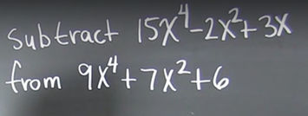
Example 2: Subtract Polynomials
Step 1: Set up equation in the proper order
Step 2: Distributive Prop
Step 3: Combine Like Terms

Slide 5
Job 19: Question 4!
Step 1: Set up equation in the proper order
Step 2: Distributive Prop
Step 3: Combine Like Terms
When 3g² – 4g + 2 is subtracted from 7g² + 5g – 1
the difference is?

Slide 6
Quiz Time!!

